Slide 1

Identifiers.org Compact Identifier resolution services MSc. Manuel Bernal Llinares EMBL-EBI
Notes:
Hello everybody, my name is Manuel Bernal Llinares and I’m the technical lead of Identifiers.org at the EBI

Slide 2
Data resources at EMBL-EBI
Genes, genomes & variation
Ensembl
Ensembl Genomes
GWAS Catalog
Metagenomics portal
Gene, protein & metabolite expression
Expression Atlas
Metabolights
PRIDE
RNA Central
Protein sequences, families & motifs
InterPro
Pfam
UniProt
Molecular structures
Protein Data Bank in Europe
Electron Microscopy Data Bank
Literature & ontologies
Experimental Factor Ontology
Gene Ontology
BioStudies
Europe PMC
Chemical biology
ChEBI
ChEMBL
SureChEMBL
Systems
BioModels
BioSamples
Enzyme Portal
IntAct
Reactome
Molecular Archives
European Nucleotide Archive
European Variation Archive
European Genome-phenome Archive
ArrayExpress
Notes:
The EBI hosts a large number of databases covering a wide range biological entities. This includes genes, genomes, protein sequences, molecular structures, pathways and ontologies etc

Slide 3
Data collections and identifiers in life sciences
Actionable identifiers embedded in URLs
https://www.ebi.ac.uk/pdbe/entry/pdb/2gc4
http://www.wormbase.org/db/gene/gene?name=WBGene00000001;class=Gene
http://www.ebi.ac.uk/ena/data/view/Taxon:9606
The same data collection is often provided by many alternative physical locations
http://www.ncbi.nlm.nih.gov/Taxonomy/Browser/wwwtax.cgi?mode=Info&id=9606
http://www.ebi.ac.uk/ena/data/view/Taxon:9606
Notes:
ALL THOSE DATABASES -> ASSIGN UNIQUE IDENTIFIERS
EMBEDDED IDENTIFIERS IN URLs
ORANGE TEXT -> LOCAL IDENTIFIER
EXAMPLE -> TAXONOMY -> BY NCBI AND ENA

Slide 4
Challenges
Multiple URLs for the same collection make object unification challenging
Which resource should be used for annotation or citation
A given location may be down, or change its URL, resulting in dead links
Notes:
HOW TO KEEP TRACK OF CHANGING URLs?
SOLUTION -> COMPACT IDENTIFIERS

Slide 5
Compact Identifiers
A unique prefix indicating the assigning authority
A locally assigned database identifier sometimes called an accession
An additional provider level prefix (provider_code) to identify individual hosts
prefix:accession
provider code/prefix:accession
Notes:
COMPACT IDENTIFIER = UNIQUE NAMESPACE + ‘:’ + LOCAL IDENTIFIER
LOCAL IDENTIFIER -> IDENTIFIER FROM A PARTICULAR RESOURCE

Slide 6
Which would you rather see?
A?
http://www.ncbi.nlm.nih.gov/Taxonomy/Browser/wwwtax.cgi?mode=Info&id=9606
http://www.rcsb.org/pdb/explore/explore.do?structureId=2gc4
http://www.wormbase.org/db/gene/gene?name=WBGene00000001;class=Gene
B?
taxon:9606
pdb:2gc4
wb:WBGene00000001

Slide 7
Support for compact in-line data citation
… the protein we used (Protein Data Bank 2gc4) in our tests …
A persistent identifier that provides access and metadata.
… the protein we used (pdb:2gc4) in our tests …
Notes:
In life sciences it is common practice to cite data entities using plain text. What we are we’re aiming for is to use Idetifiers.org combined with compact identifiers to support a shorter, but machine-readable, persistent, and less ambiguous citation.

Slide 8


Compact Identifier Resolution Services
Actionable Compact Identifiers provide unique stable, resolvable and location-independent URIs to identify and locate data objects
http://www.ebi.ac.uk/ena/data/view/Taxon:9606
http://www.ncbi.nlm.nih.gov/Taxonomy/Browser/wwwtax.cgi?mode=Info&id=9606
taxon:9606
http://purl.uniprot.org/taxonomy/9606
http://taxonomy.bio2rdf.org/describe/?url=http://bio2rdf.org/taxonomy:9606
http://www.ebi.ac.uk/ols/ontologies/ncbitaxon/terms?short_form=NCBITaxon_9606
http://purl.bioontology.org/ontology/NCBITAXON/9606
https://identifiers.org/taxon:9606
https://n2t.net/taxon:9606
Notes:
HOW TO GO FROM COMPACT IDENTIFIER –>TO→ RESOURCE?
COMPACT IDENTIFIERS RESOLUTION SERVICE A.K.A. METARESOLVER

Slide 9
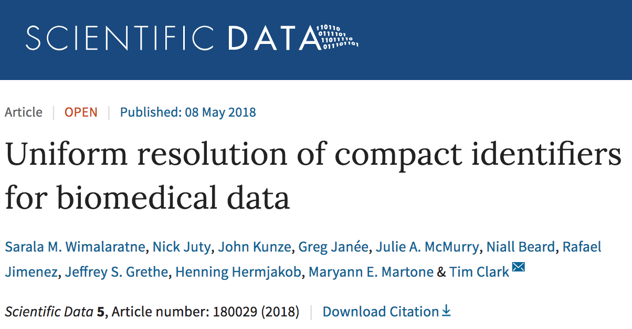

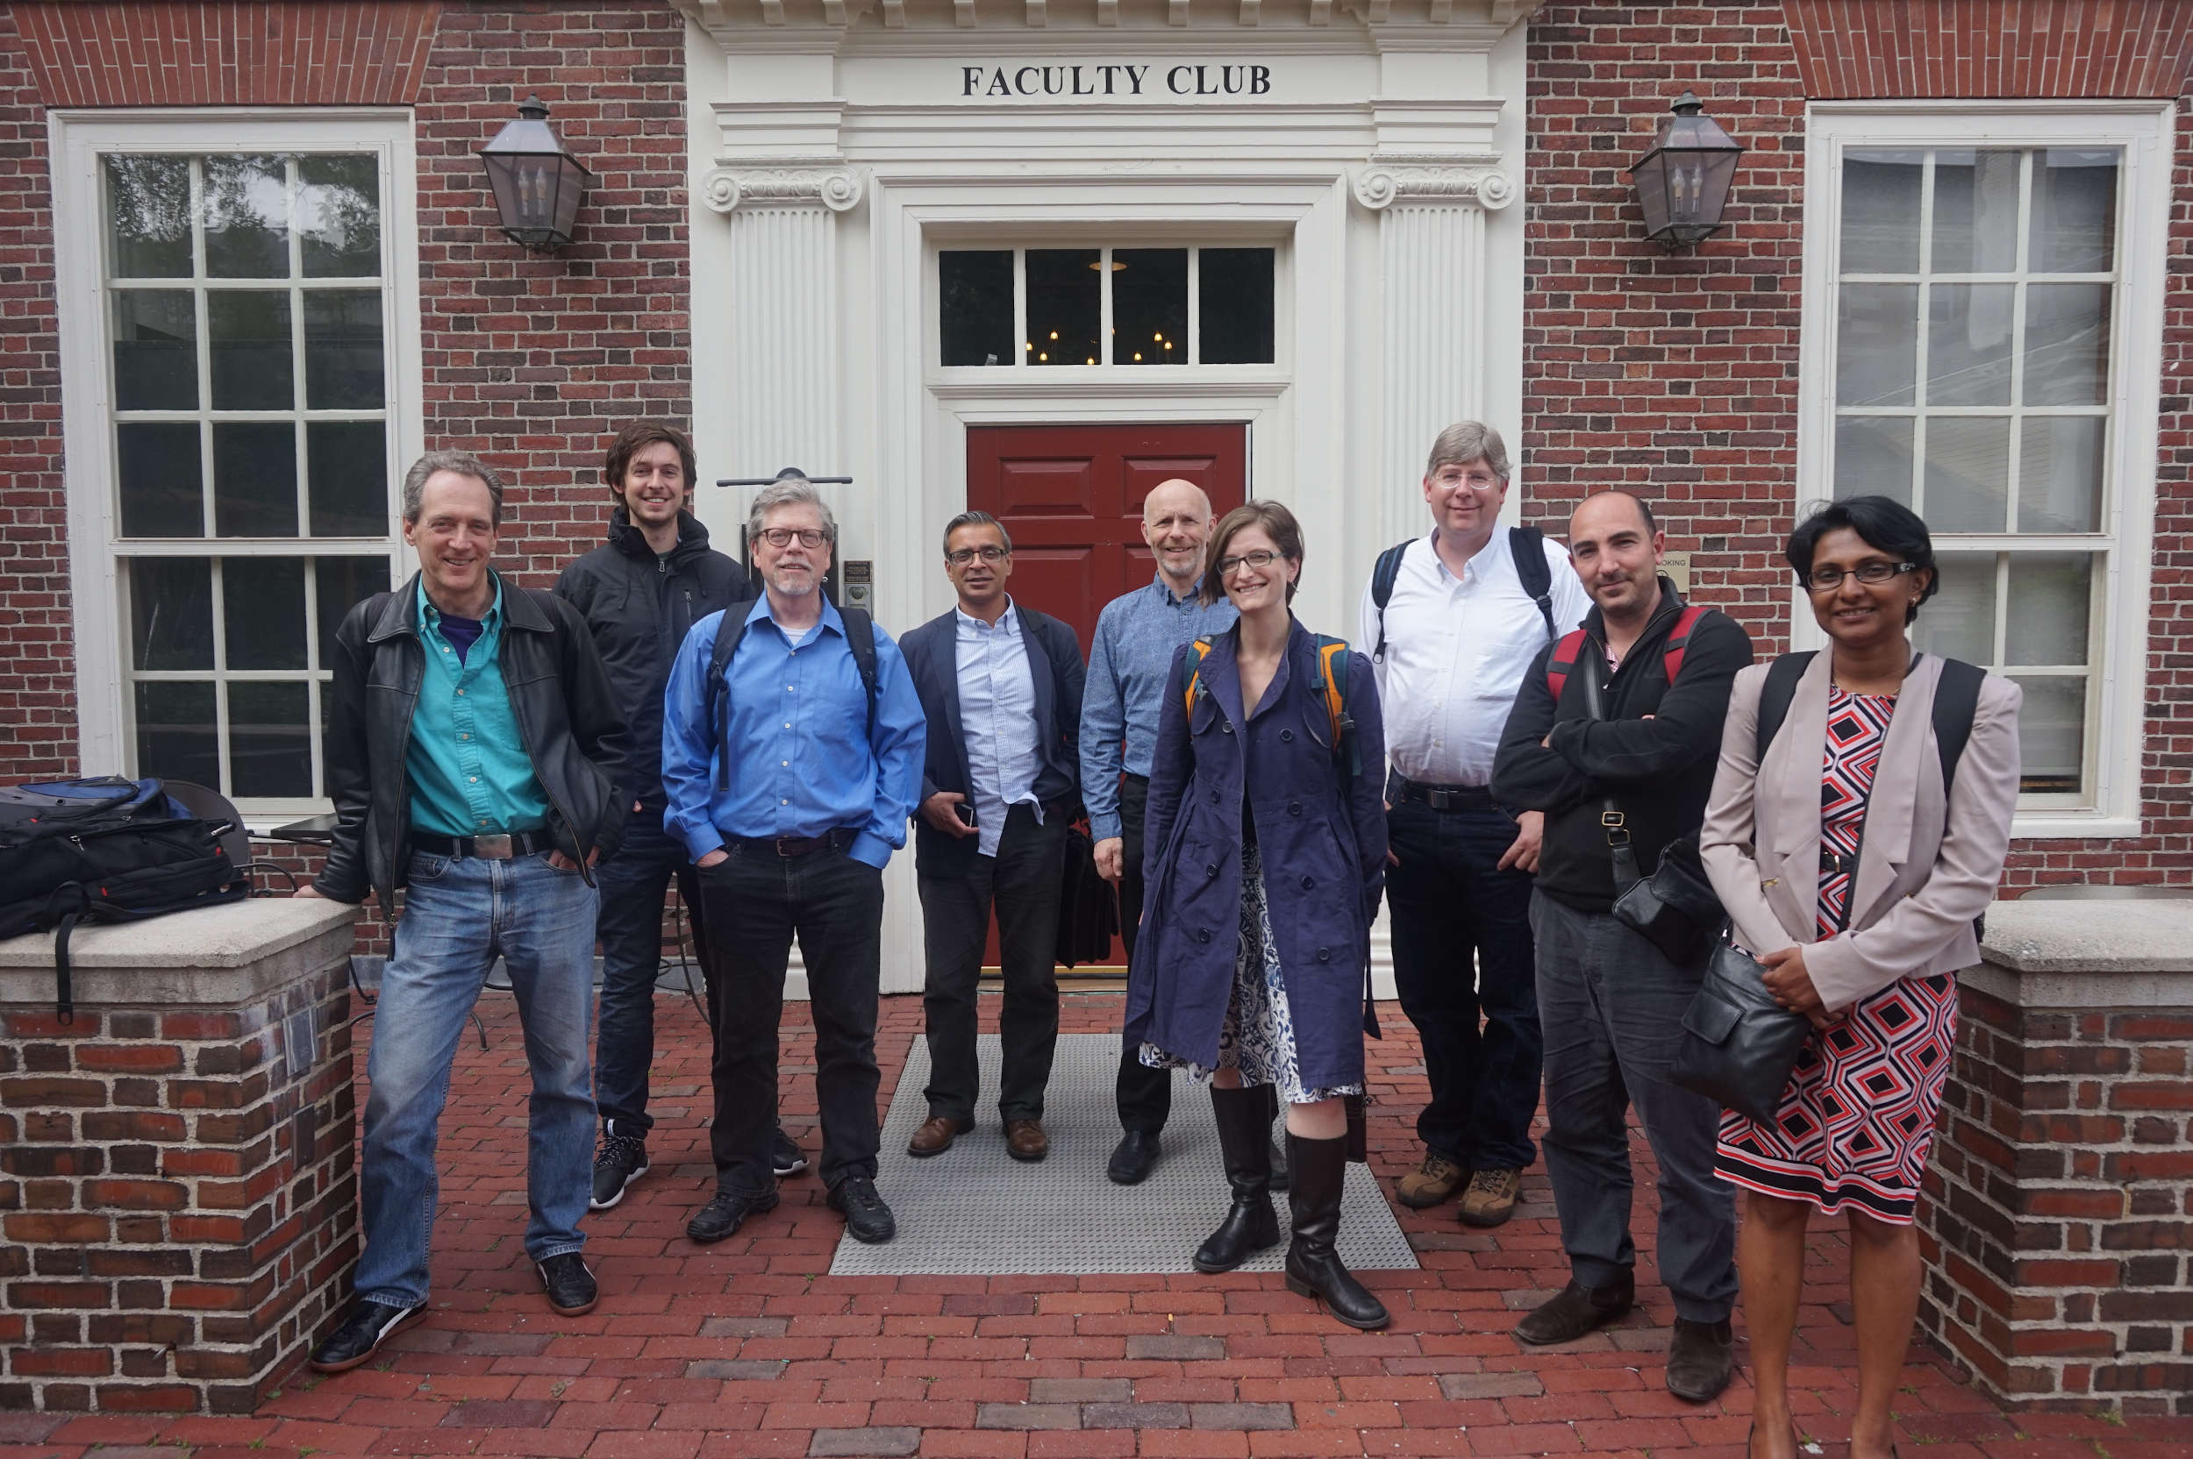


Meta-resolver harmoni(z|s)ation
Notes:
COMPACT IDENTIFIERS ARE WELL SUPPORTED
FIND OUT MORE ON NATURE SCIENTIFIC DATA PUBLICATION
MOU BETWEEN CDL AND EBI
NATURE SCIENTIFIC DATA IS USING COMPACT IDENTIFIERS IDENTIFIERS.ORG METARESOLVER WITHIN THEIR PUBLISHING WORKFLOW
PAPERS AFTER MAY THIS YEAR SHOULD BE USING COMPACT IDENTIFIERS FOR CITATION AND ANNOTATION

Slide 10
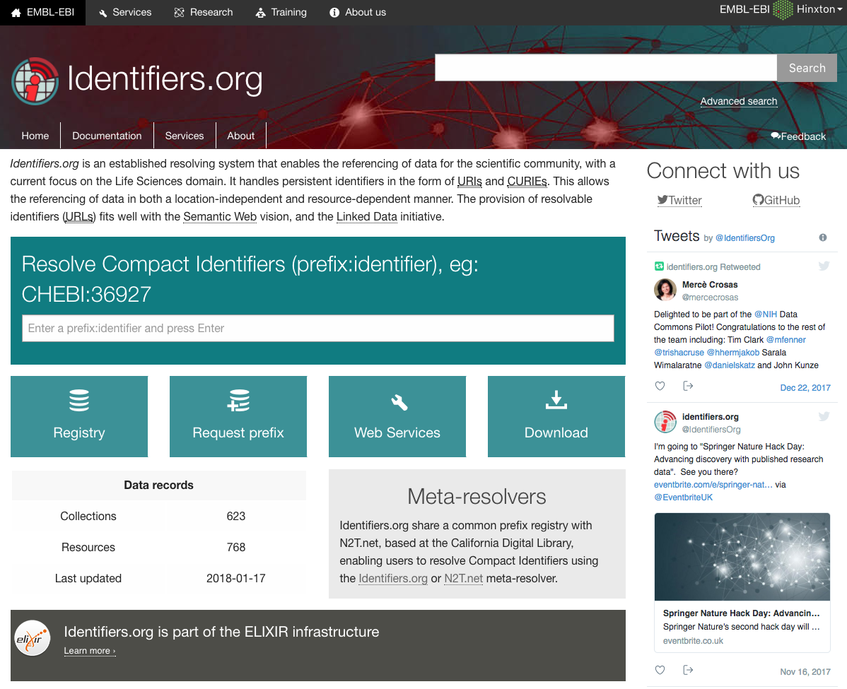
Identifiers.org
Freya – PID core services
NIH-DCPPC – GUID services
http://cloud.identifiers.org
2018
2017
Stable Elixir system
2016
Compact Identifier support
2014
Linked data integration
2005
Nature biotechnology perspective
https://identifiers.org
Notes:
QUICKLY INTRODUCTION OF IDENTIFIERS.ORG
SINCE 2005
INVOLVED IN TWO MAJOR PROJECTS WITH US AND EU
AND WE ARE REBUILDING OUR PLATFORM ON THE CLOUD
CLOUD.IDENTIFIERS.ORG

Slide 11
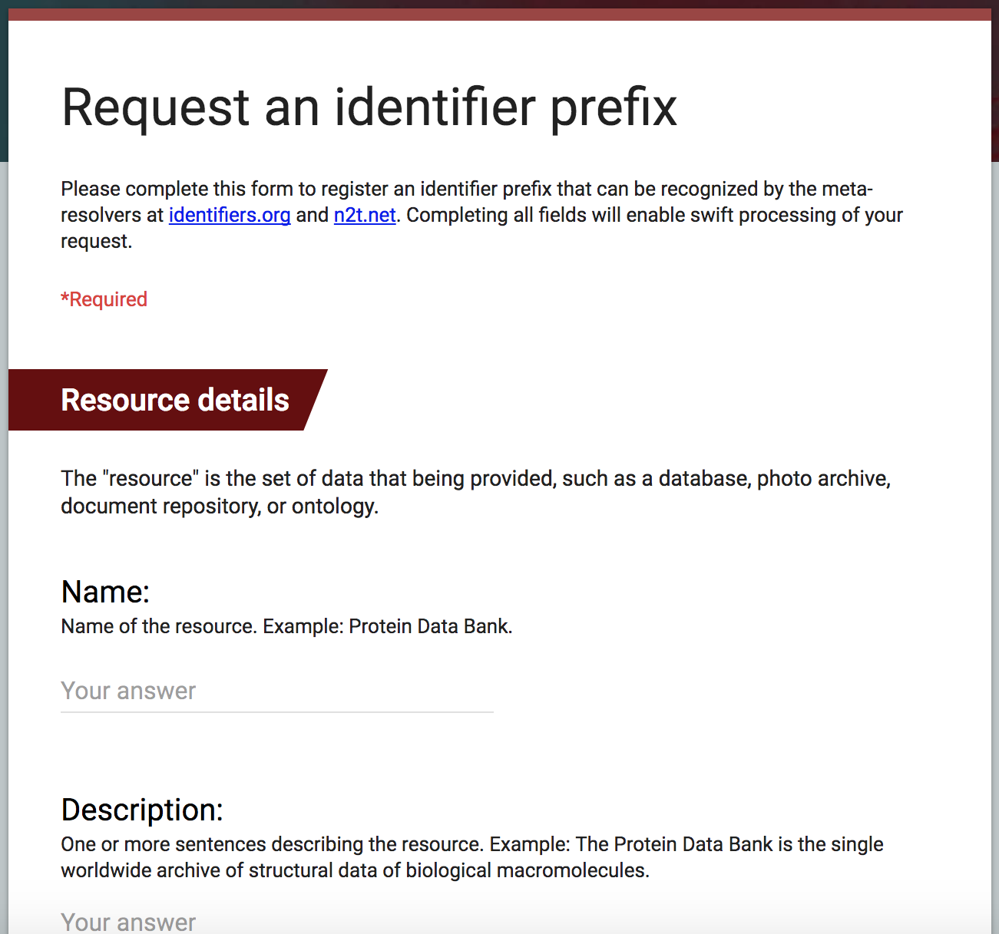
Register Prefixes for Compact Identifiers
Identifiers.org Registry is a manually curated resource of over 650 life science data collections with metadata, alternative access URLs, and identifier patterns.
https://identifiers.org/request/prefix

Slide 12
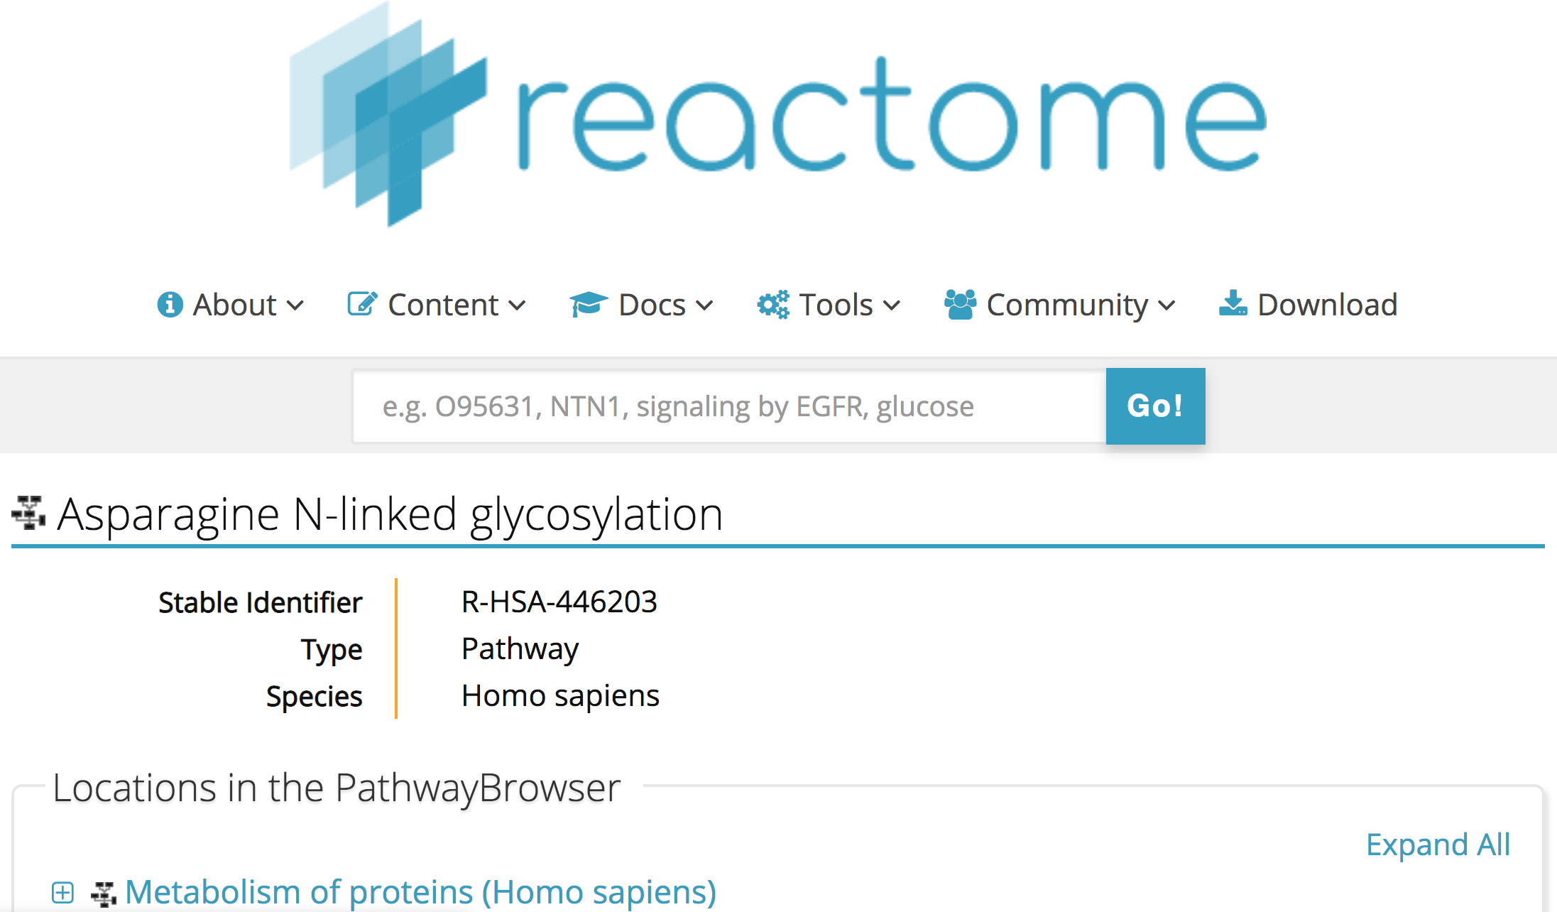
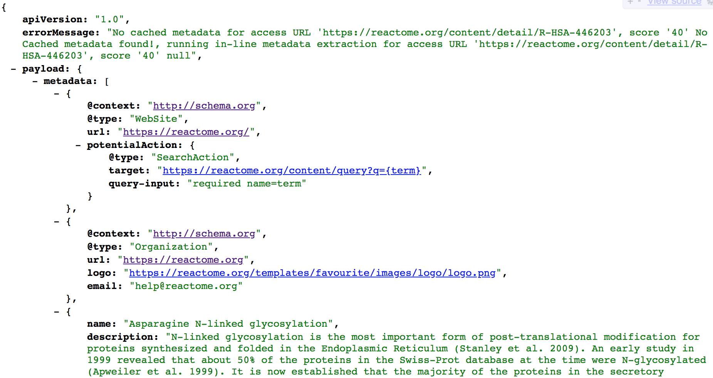
Compact Identifier Metadata
Idenifiers.org metadata service provides access to the Compact Identifier Schema.org metadata encoded by the resource providers.
reactome:R-HSA-446203
http://metadata.api.identifiers.org/reactome:R-HSA-446203
http://metadata.api.identifiers.org/{Compact Identifier}
Notes:
WE SUPPORT SCHEMA.ORG METADATA
WE HAVE A METADATA EXTRACTION SERVICE FROM COMPACT IDENTIFIERS
IT IS PART OF OUR NEW CLOUD INFRASTRUCTURE

Slide 13
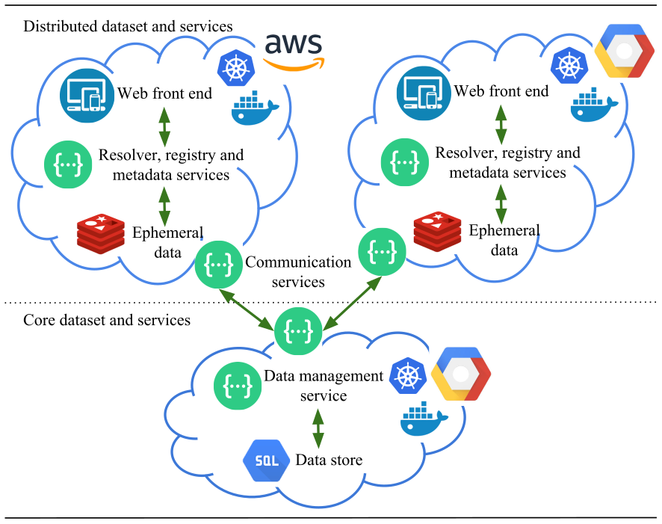
Identifiers.org in the cloud
http://cloud.identifiers.org
Notes:
OVERVIEW SNAPSHOT OF OUR CLOUD INFRASTRUCTURE

Slide 14
Hackathon Activities
Access Identifiers.org services via the cloud-libapi
Test our cloud infrastructure at http://cloud.identifiers.org
Deploy your own Identifiers.org services in the cloud
Contribute to development of identifiersJS package for accessing Identifiers.org services
Notes:
FREEFORM WALK IN HACKING
TRY THINGS, BREAK THINGS
SERVICES, BROWSER PLUGINS
CLIENTS (Python, C++, R)
CLOUD -> FREE CREDITS
HACK!
HACK!
HACK!

Slide 15




Acknowledgements
EMBL-EBI
Henning Hermjakob
Sarala Wimalaratne
California Digital Library
John Kunze
Greg Janee
The University of Manchester
Nick Juty
Harvard University
Timothy Clark
Elixir Hub
Rafael Jimenez
Funding
Excelerate/676559, EU/312455, THOR/654039, BB/J019305/1, BB/E006248/1, OpenPhacts/115191, NIH/1U41HG006104
Contact
sarala@ebi.ac.uk

Slide 16

Annotate and Cite
your data using
Compact Identifiers
taxon:9606

